Slide 1
Merchandise Website
David Hajek, Elisabeth Sykorova, Tymoteusz Walichnowski

Slide 2
Introduction & Theme Rationale

Slide 3
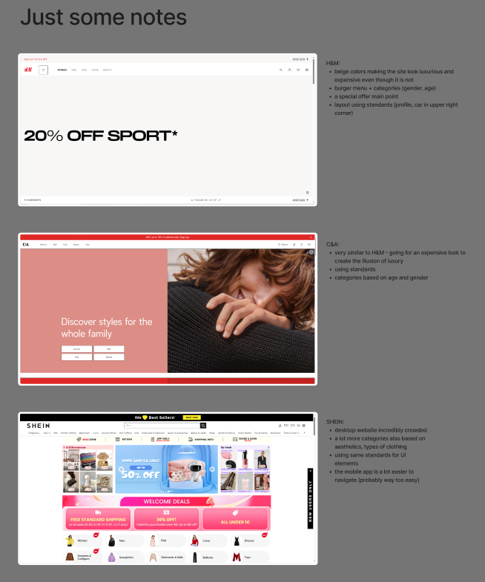
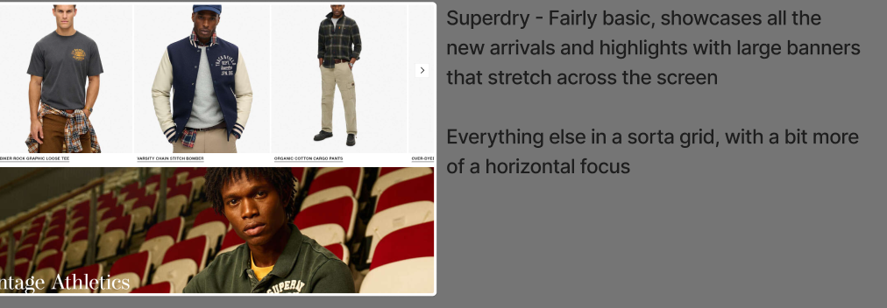
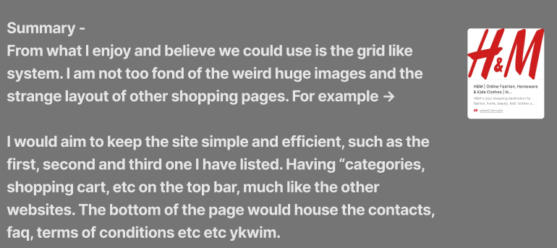
1. Wanted to create a shopping website
- screenshots from our Figma work board

Slide 4
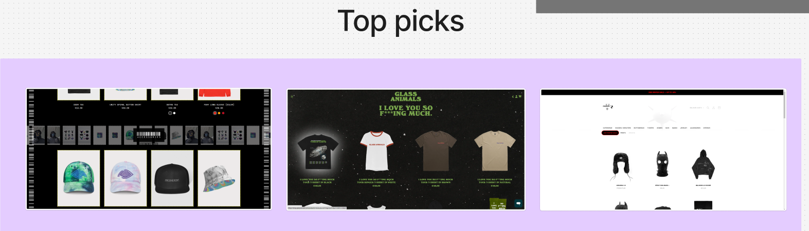
2. Needed a more niche focus
- screenshots from our Figma work board

Slide 5
3. Chosen Theme = Merchandise Website

Slide 6
Analyzed Websites

Slide 7
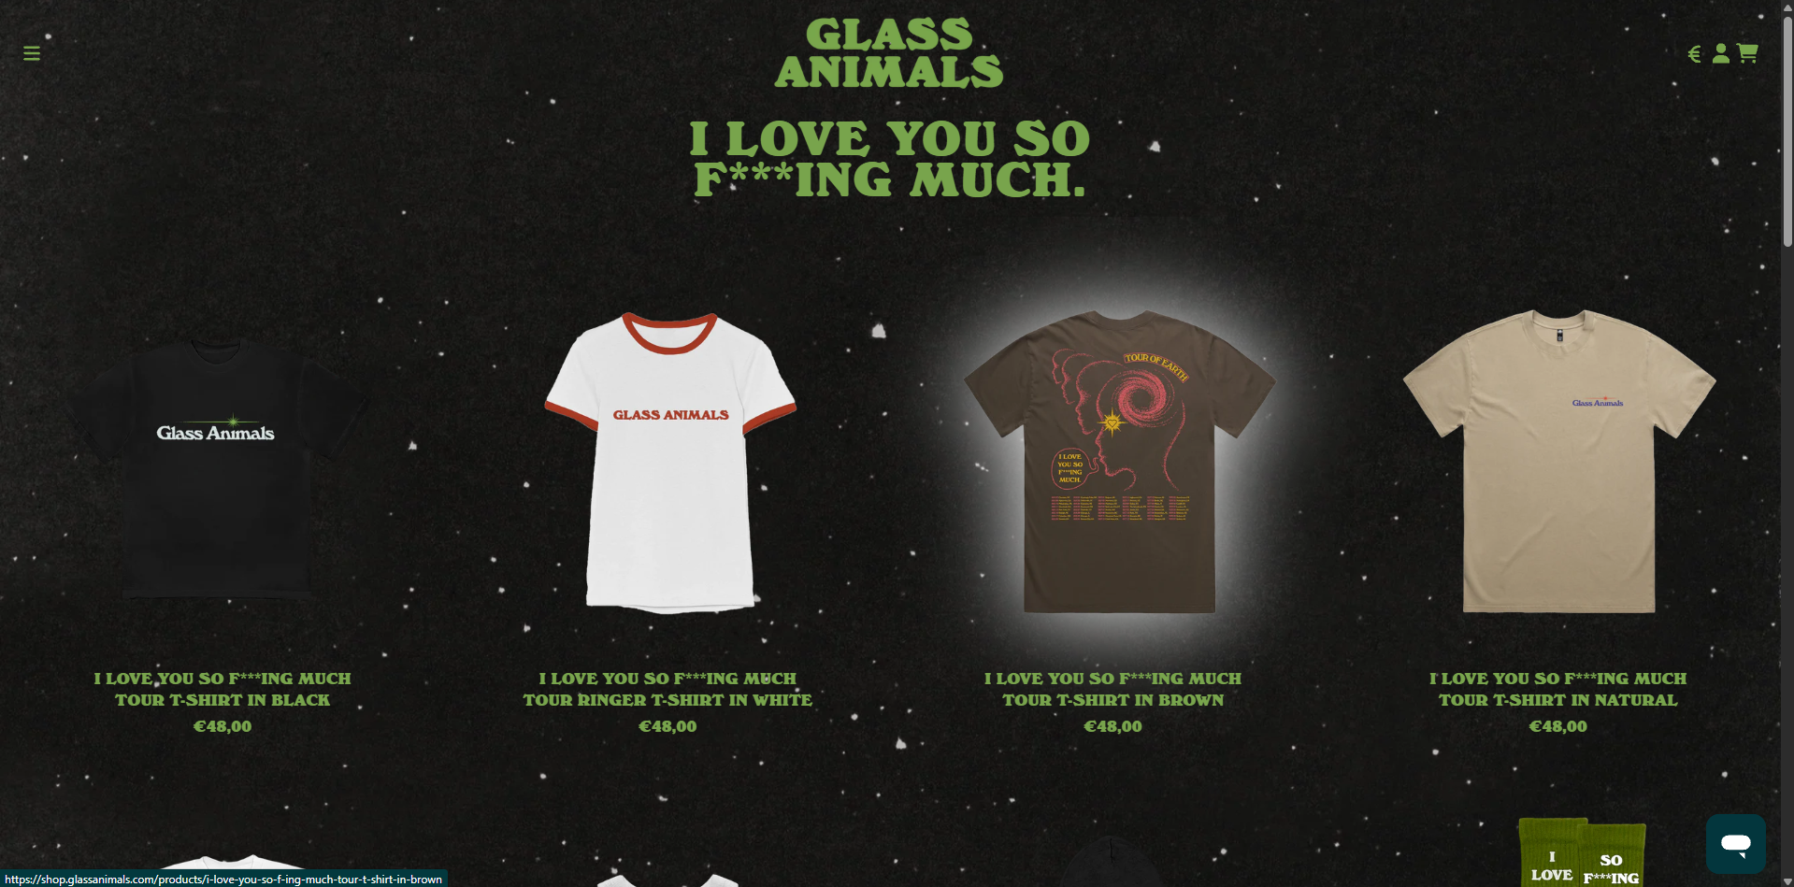
Analyzed Website 1
https://shop.glassanimals.com/

Slide 8
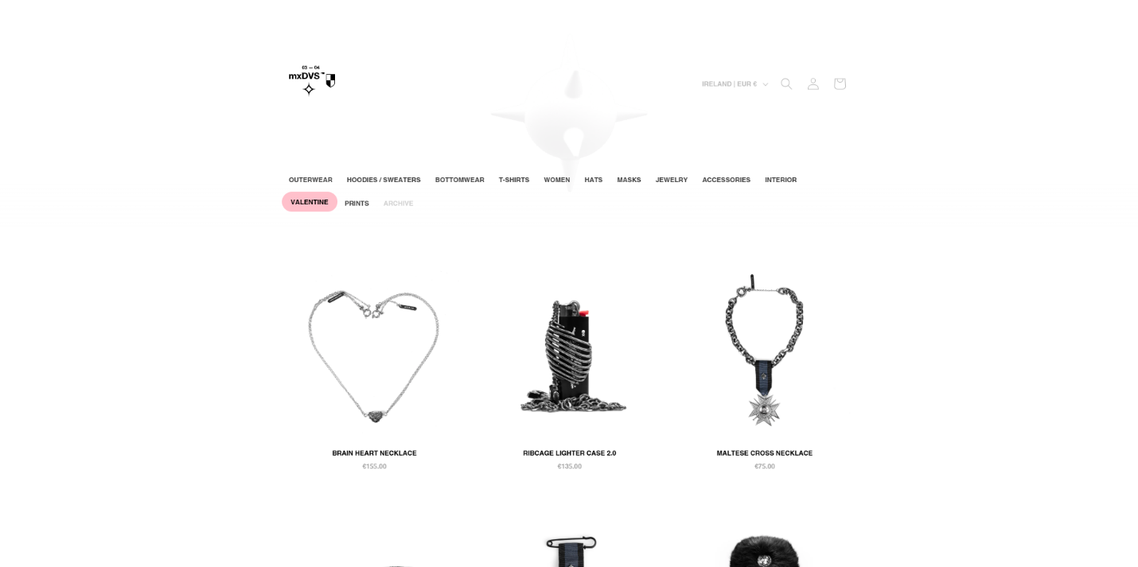
Analyzed Website 2
store.mxdvs.co

Slide 9
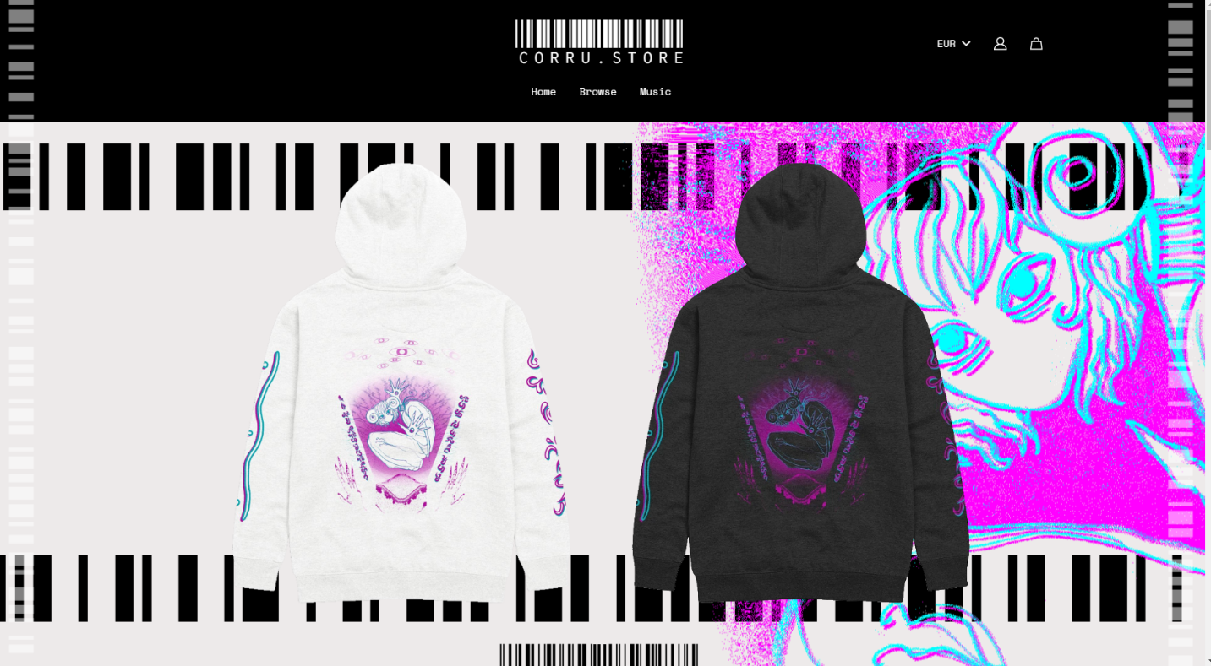
Analyzed Website 3
corru.store

Slide 10
Research & User Insights

Slide 11
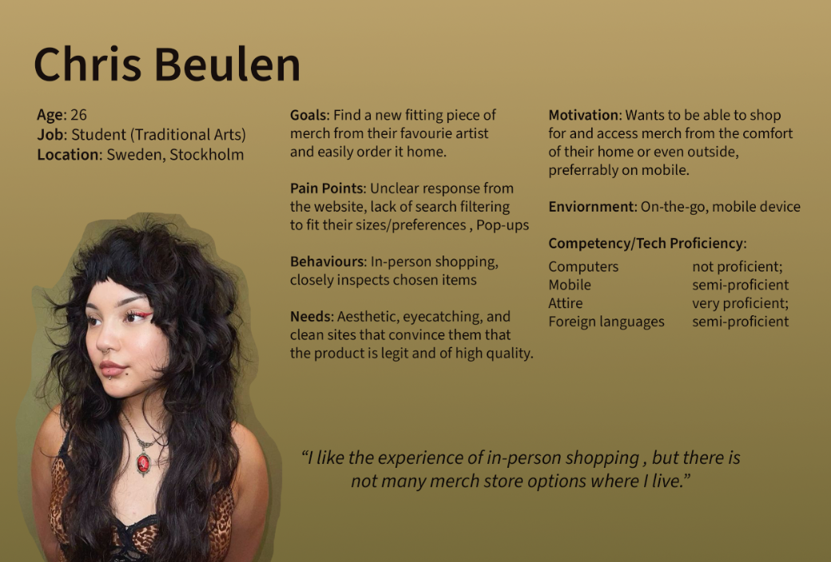
User Persona 1

Slide 12
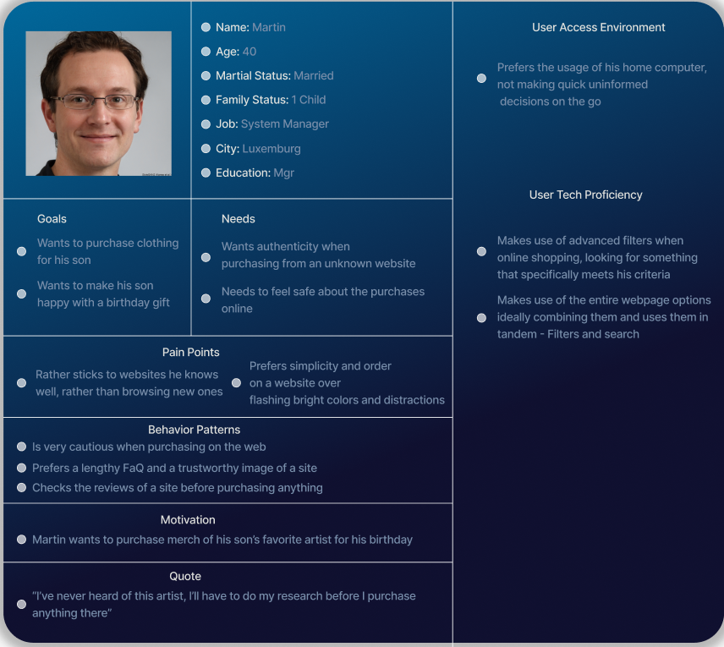
User Persona 2

Slide 13
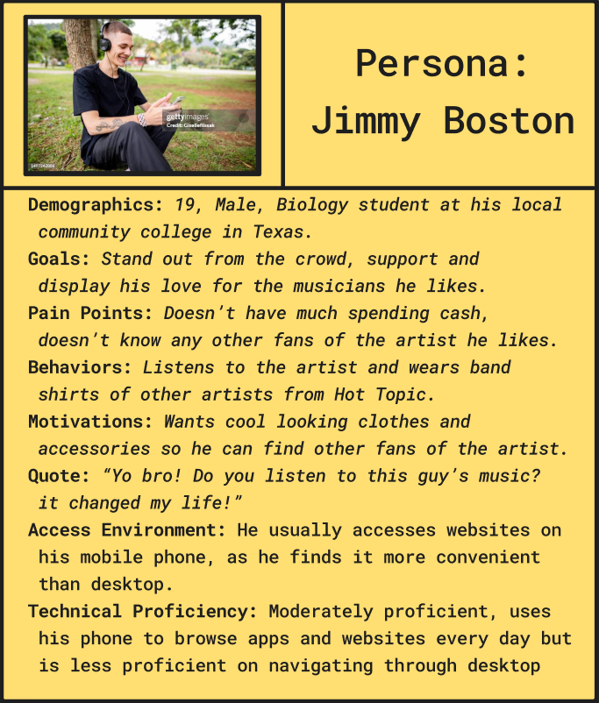
User Persona 3

Slide 14
Goals & Value Proposition

Slide 15
> Combine the uniqueness and aesthetic appeal of heavily stylized sites that omit accessibility and usability, and the practical aspect of less visually interesting sites that have user-friendly design and features.

Slide 16
Preliminary Designs & Feedback

Slide 17
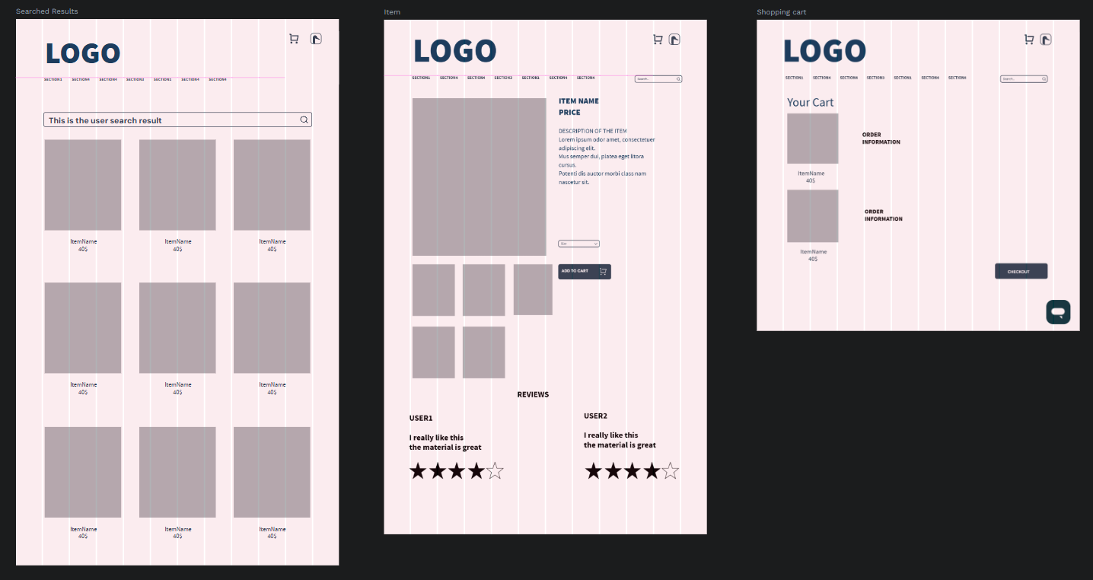
Wireframes
(Penpot)

Slide 18
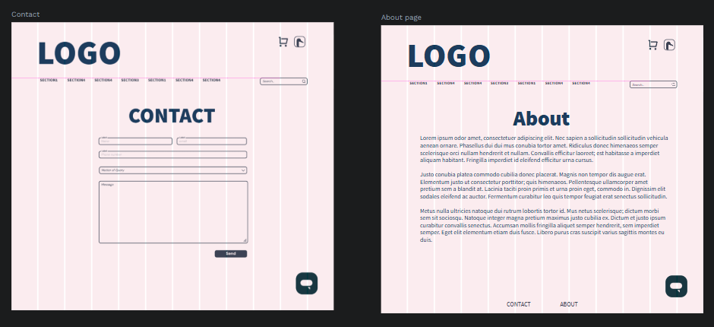
Wireframes
(Penpot)

Slide 19
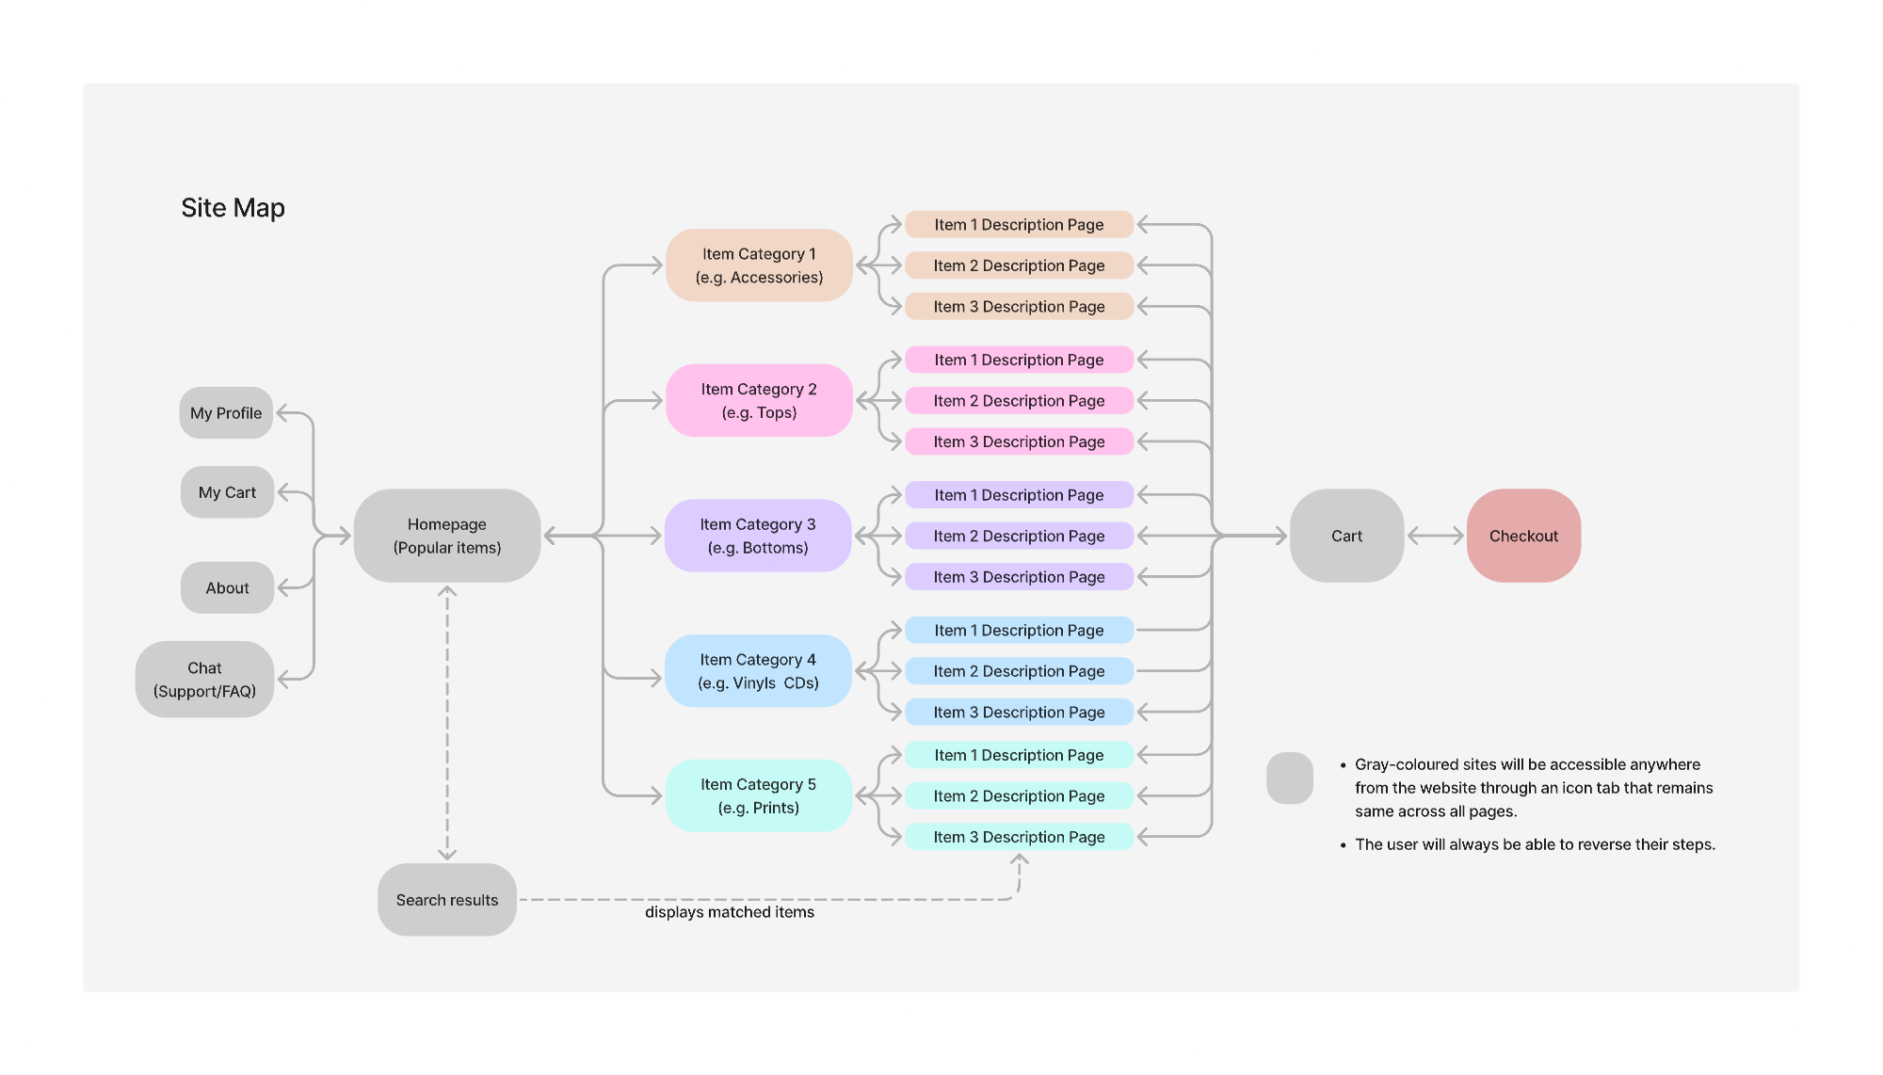
Site Map

Slide 20
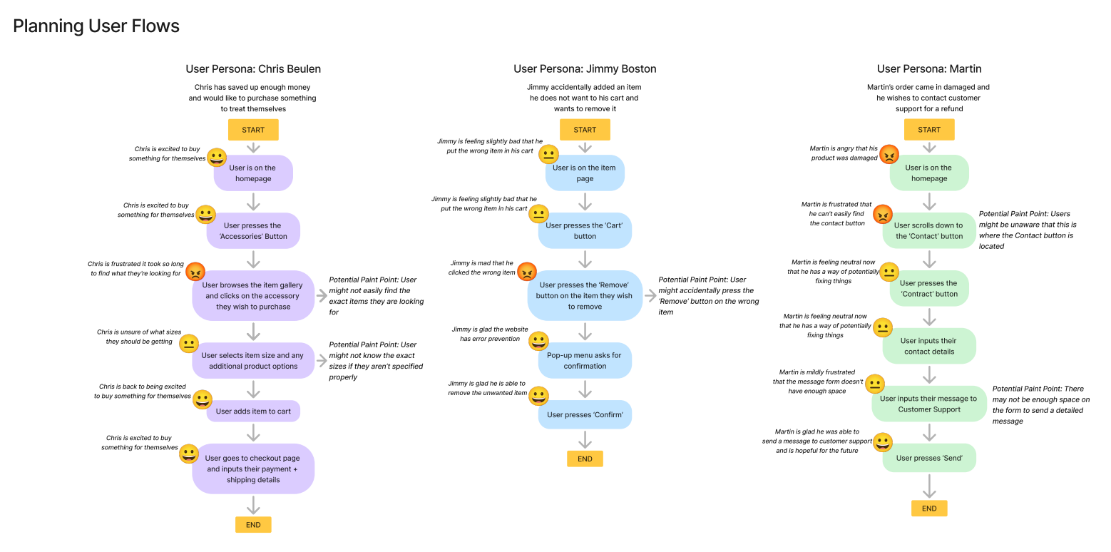
User Flows

Slide 21
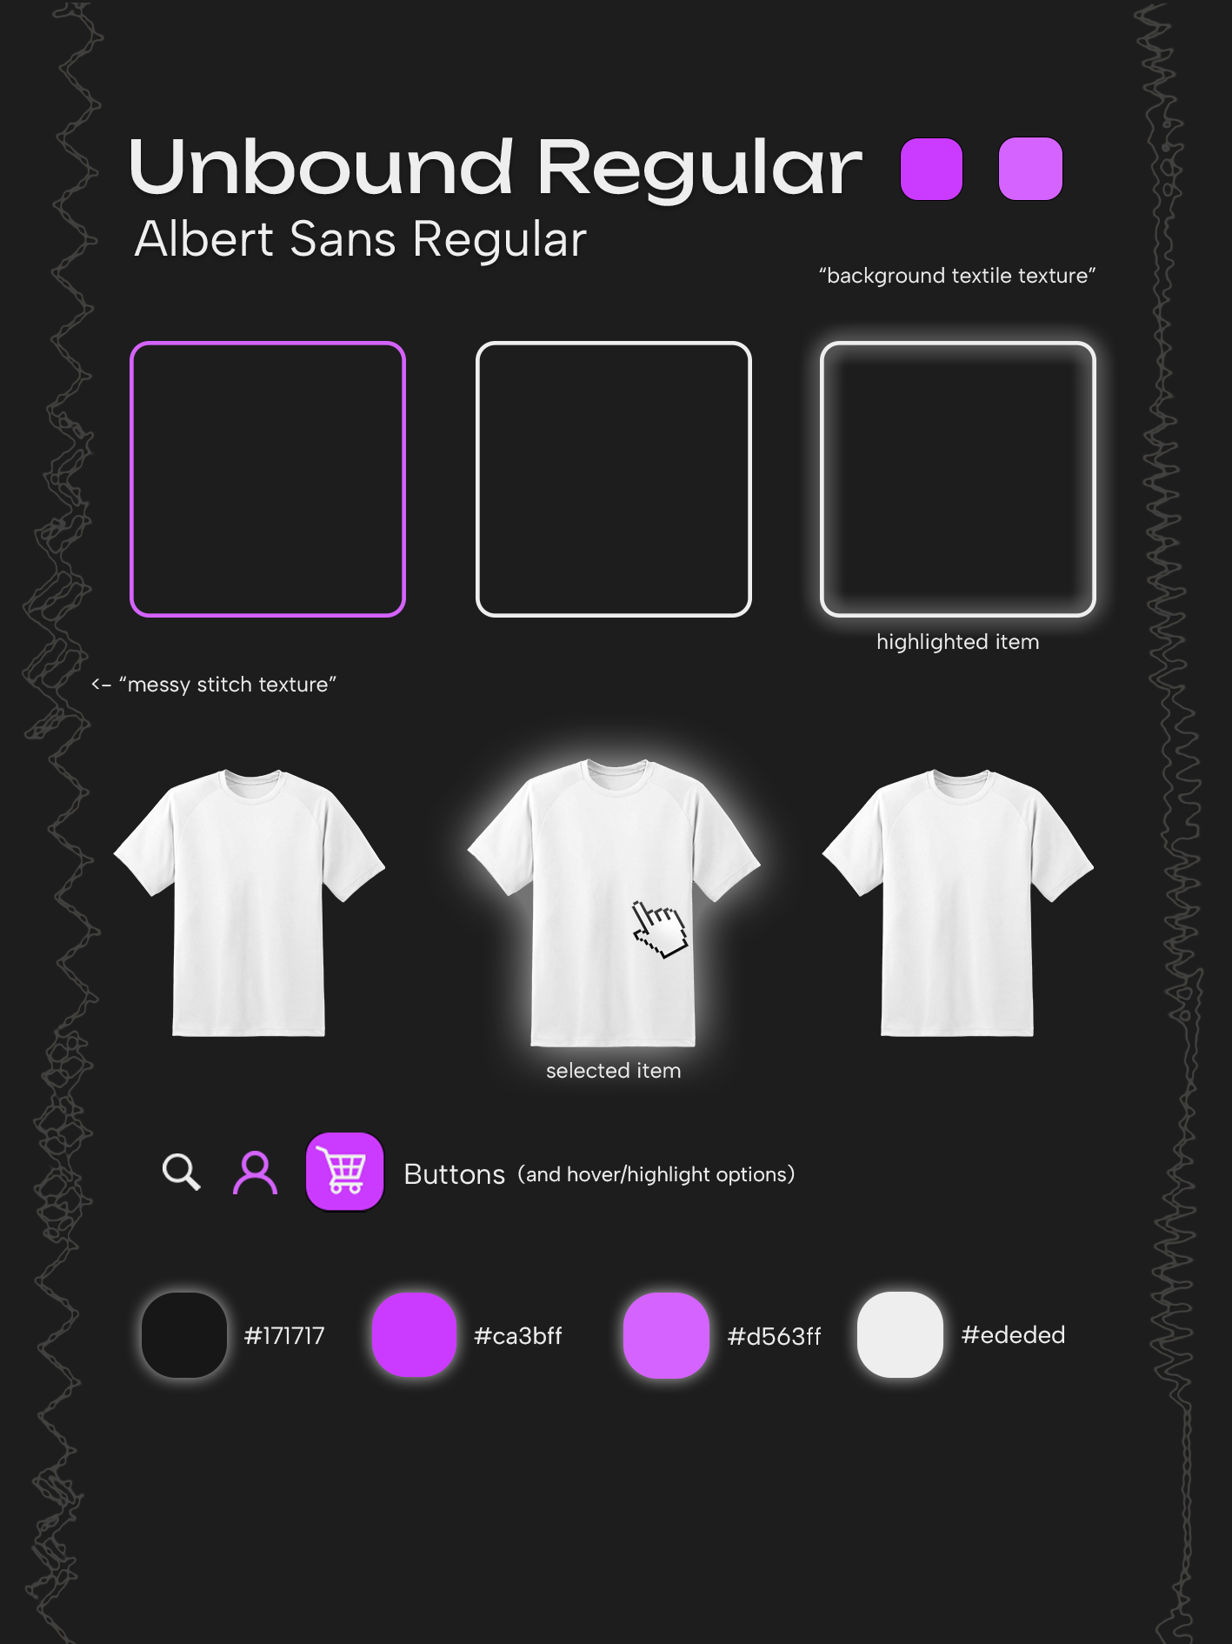
Moodboard

Slide 22
Development & Responsiveness

Slide 23
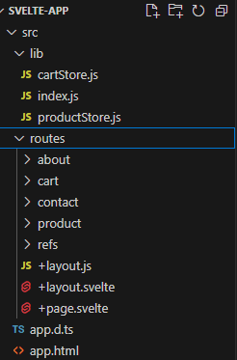
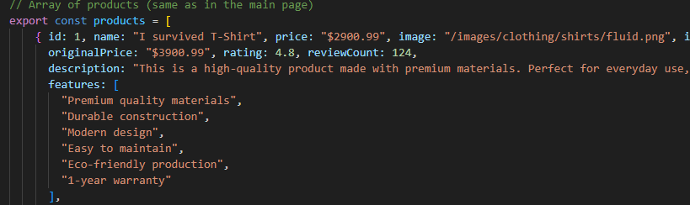
Svelte Setup
Using .JS to store data throughout the store page (products and their info)
Dream setup →

Slide 24
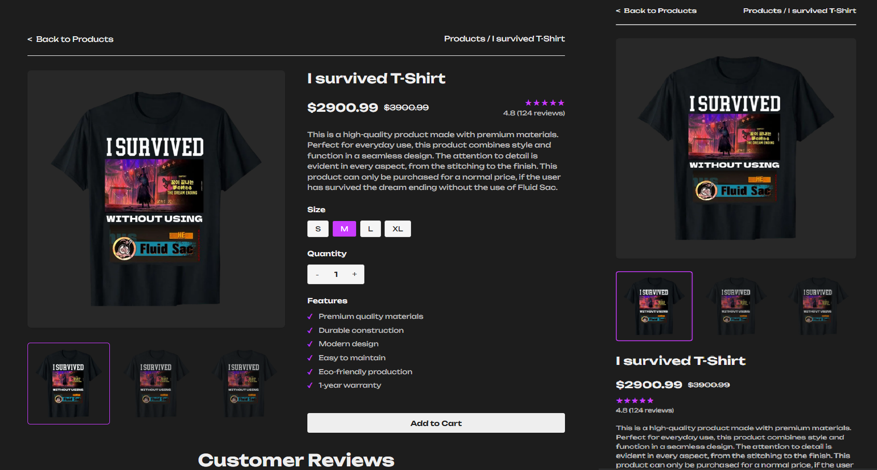
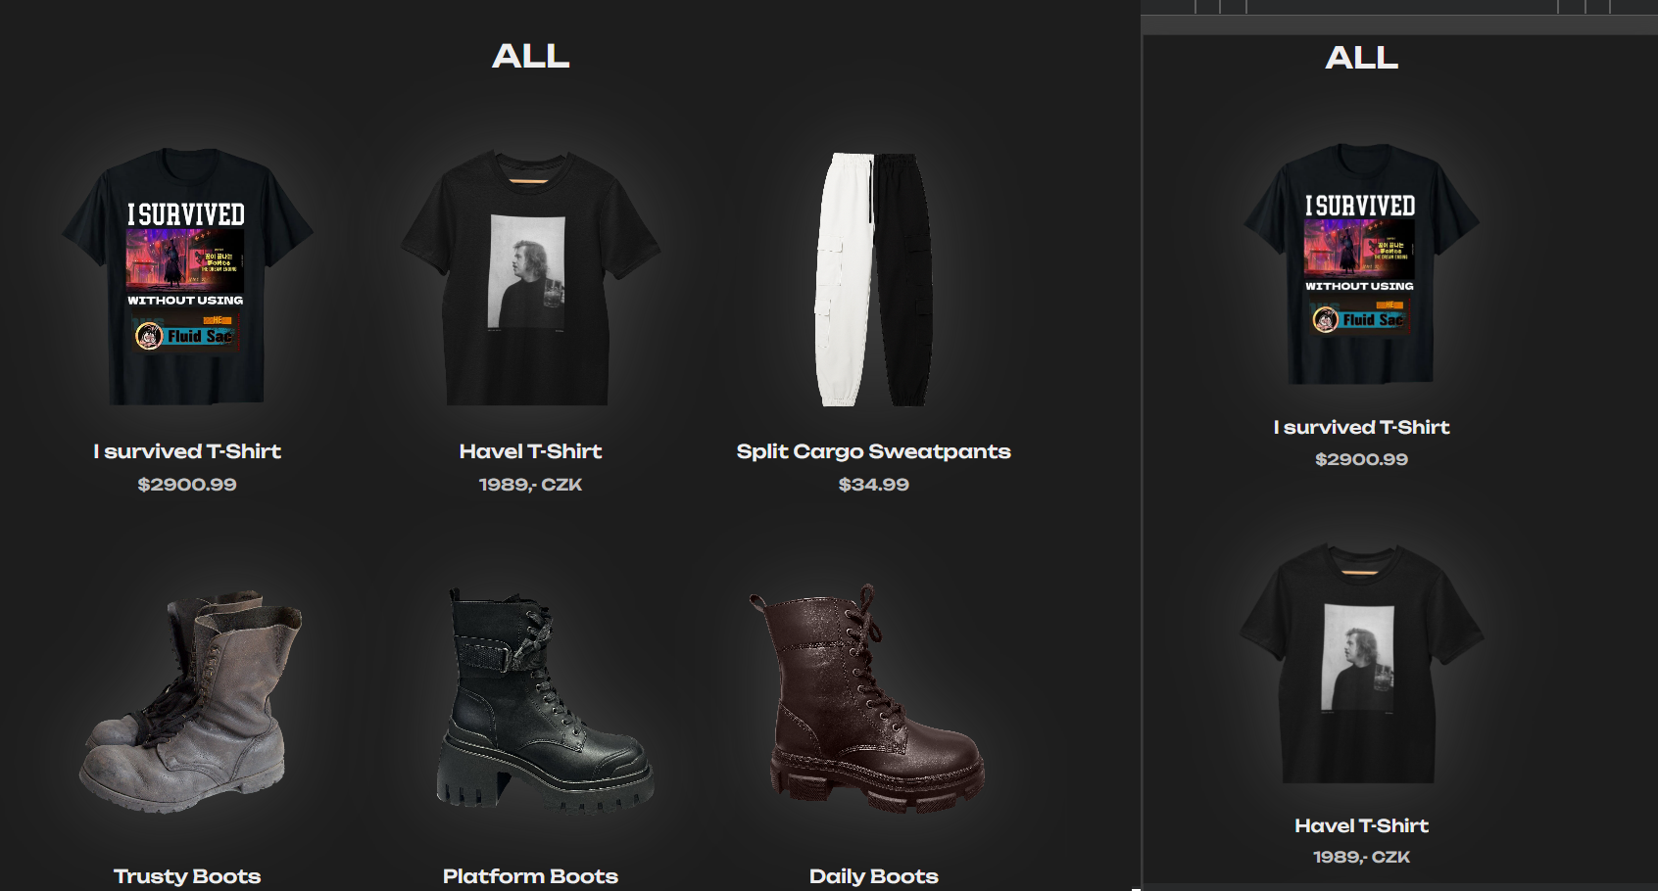
Mobile Layout(s)

Slide 25
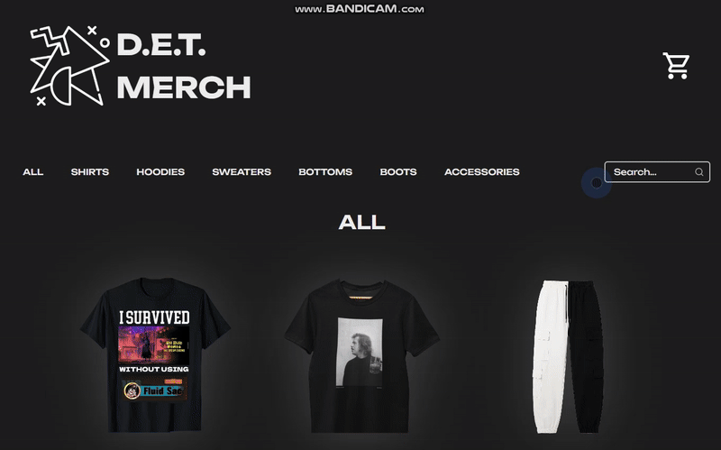
Interaction

Slide 26
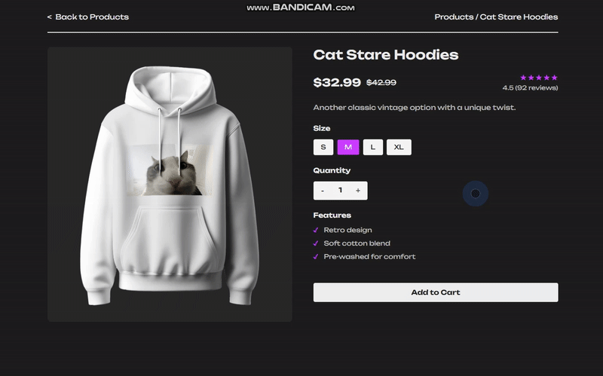

Slide 27
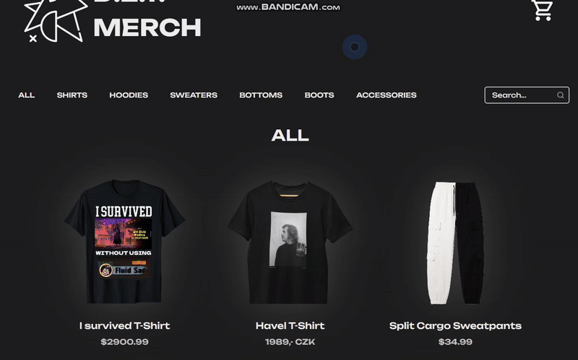

Slide 28
Testing, Optimisation & Deployment

Slide 29
Usability Tests
We asked classmates to test our website and recorded their responses.
Overall, the results were positive, but one or two key issues came up
The navigation scheme was very simple, with all the categories being at the top of the webpage and the about/contact being at the footer
They found it easy to browse the home page for items and find whatever they were searching for, nothing on the site was too visually overstimulating.
They attempted to exit out of the cart tab by clicking outside of it, which is a key feature of many shopping sites that was absent from our own.

Slide 30
Performance Improvements
There weren’t many performance improvements that we had to make while working on the site
One of the main ones was the category system, where rather than having multiple category pages, we had one home page, that would *filter* items based on what category they were marked as.
A similar system was used for the product page, where we only had one product page, and it would load in the details of whatever the currently selected item was

Slide 31
Deployment
FINAL LIVE URL: https://david-hajek.github.io/Web-UI-Design-Group-Project/
Lessons we Learned
Svelte can be really finnicky
It can be easy to overlook common user designs principles

Slide 32
Reflection & Future Steps

Slide 33
Takeaways and Potential Enhancements
For our next website, we will be more knowledgeable on website deployment for GitHub pages
We will know what to expect from Svelte, and how to handle errors when they eventually appear
Have fun while doing it! :)

Slide 34
Thank you for your attention :) – D, E, T

